Slide 1


PREDICTIVE AGRICULTURAL ANALYTICS

Slide 2

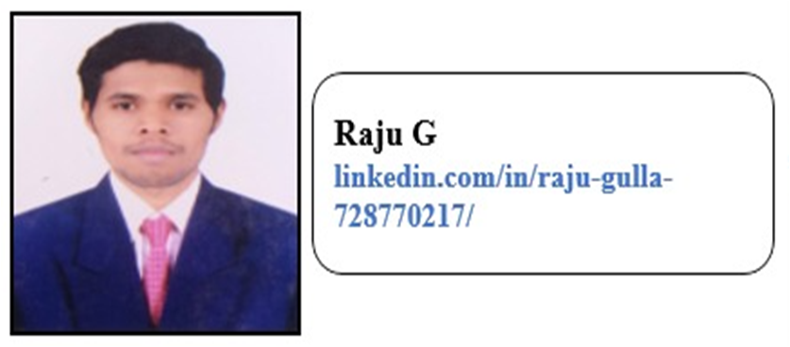
Project Manager
Mr. Sharath Manikonda
Director at Innodatatics :
https://www.linkedin.com/in/sharat-chandra
Raju Kalyan
https://www.linkedin.com/in/raju-kalyan-728770217/

Slide 3
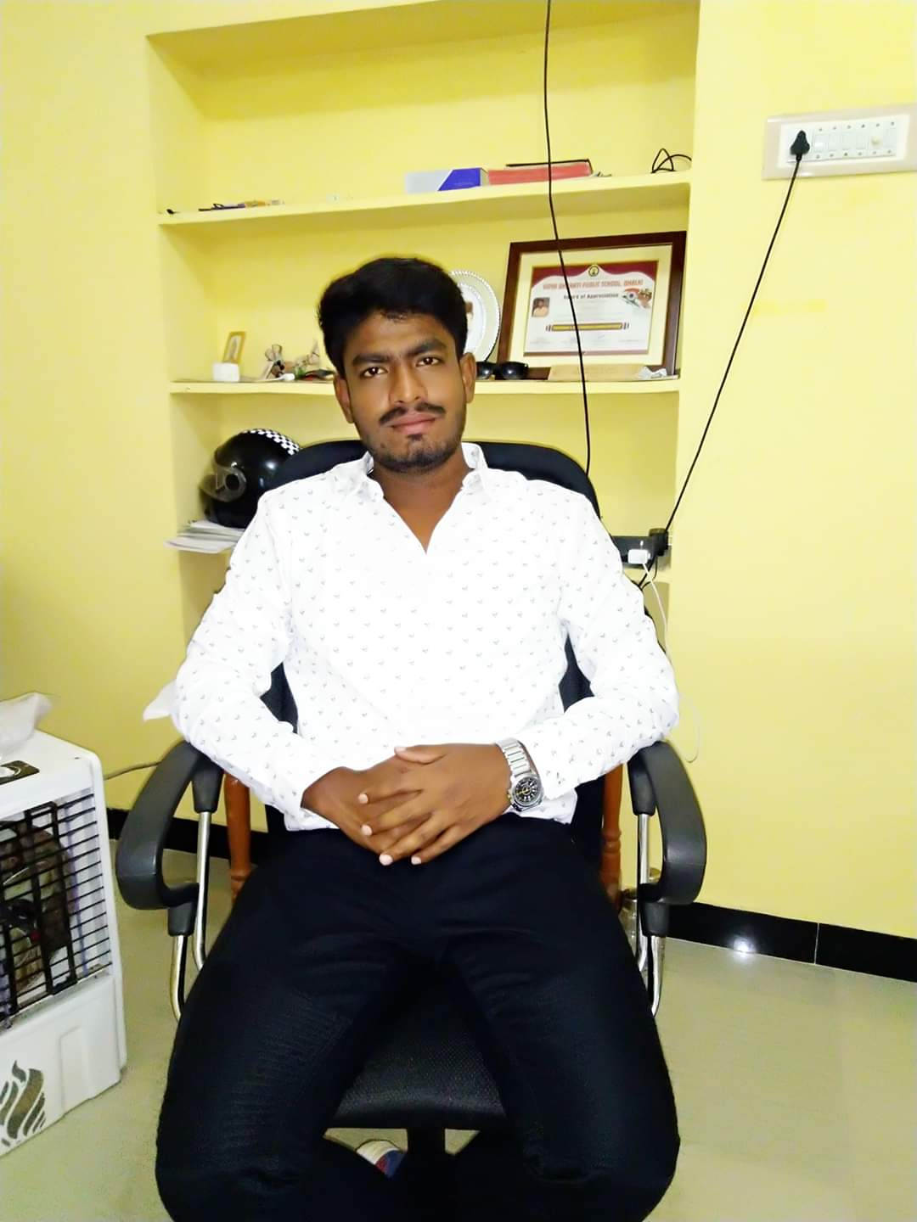

Project Mentor
Emmanuel Sir (Mentor of Project)
https://www.linkedin.com/in/emmanuel-mitra-0a13b2216
Aspak sir (Mentor of Project)
https://www.linkedin.com/in/ashpak-sheikh-235509168

Slide 4


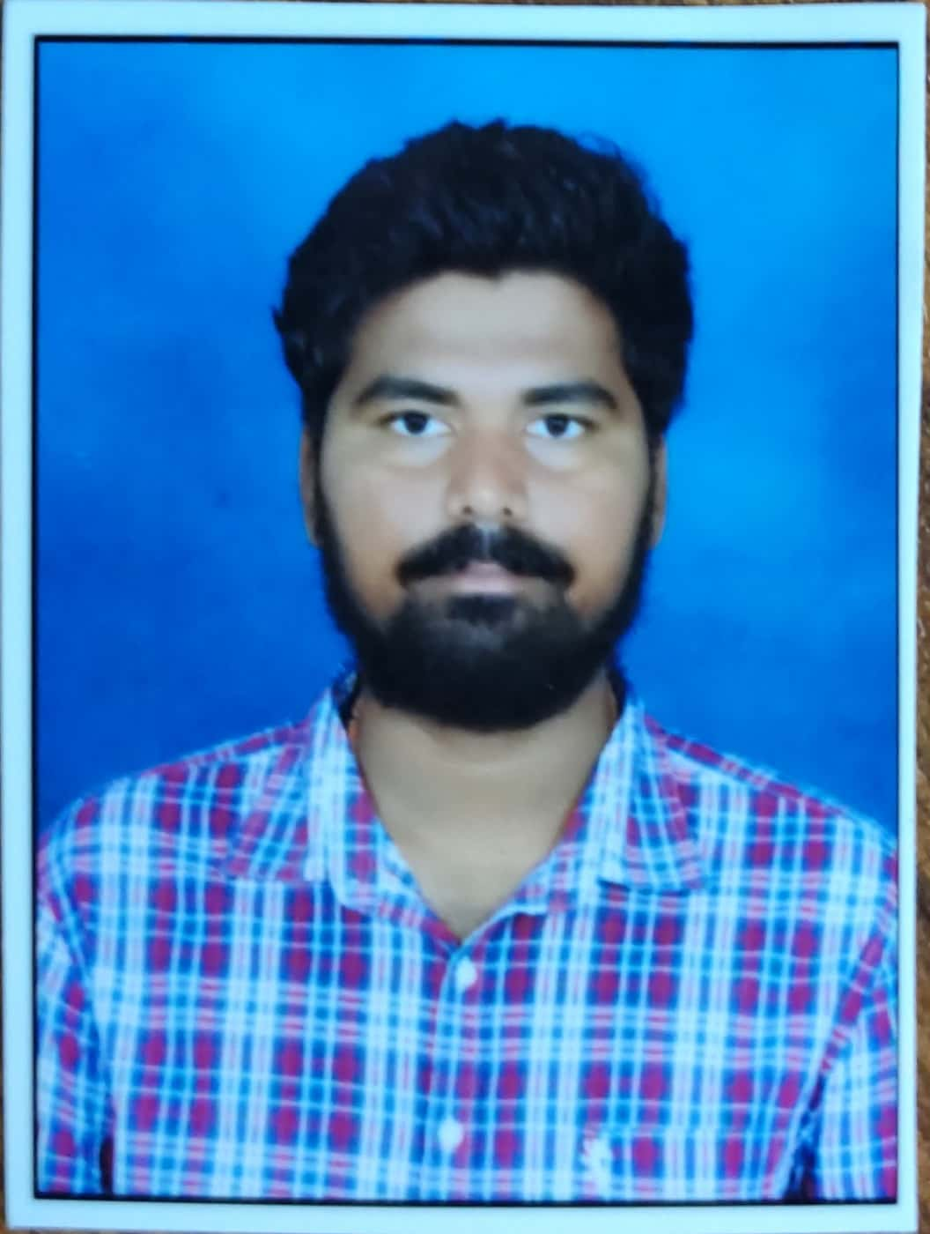
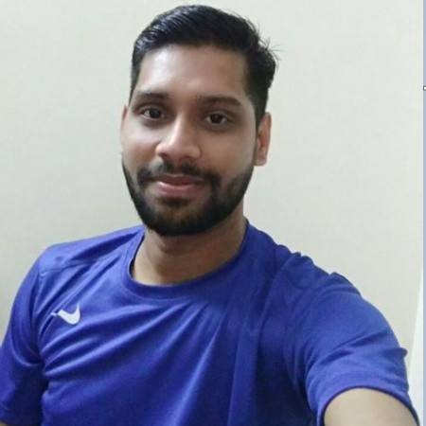


Team Members
NAYAN SONI
https://www.linkedin.com/in/nayan-soni-32277b217/
Giragani pallavi
https://www.linkedin.com/in/giragani-pallavi-0bb02a20a/
Thanneru Akhil
https://www.linkedin.com/in/thanneru-akhil-2843ab146
MD TARIQUE ANWER https://www.linkedin.com/in/md-tarique-anwer-370b57109/
Shubham M Mungade
https://www.linkedin.com/in/shubham-mungade-a33170205
Deepali Agarwal
https://www.linkedin.com/in/deepaliagarwal28da8/

Slide 5




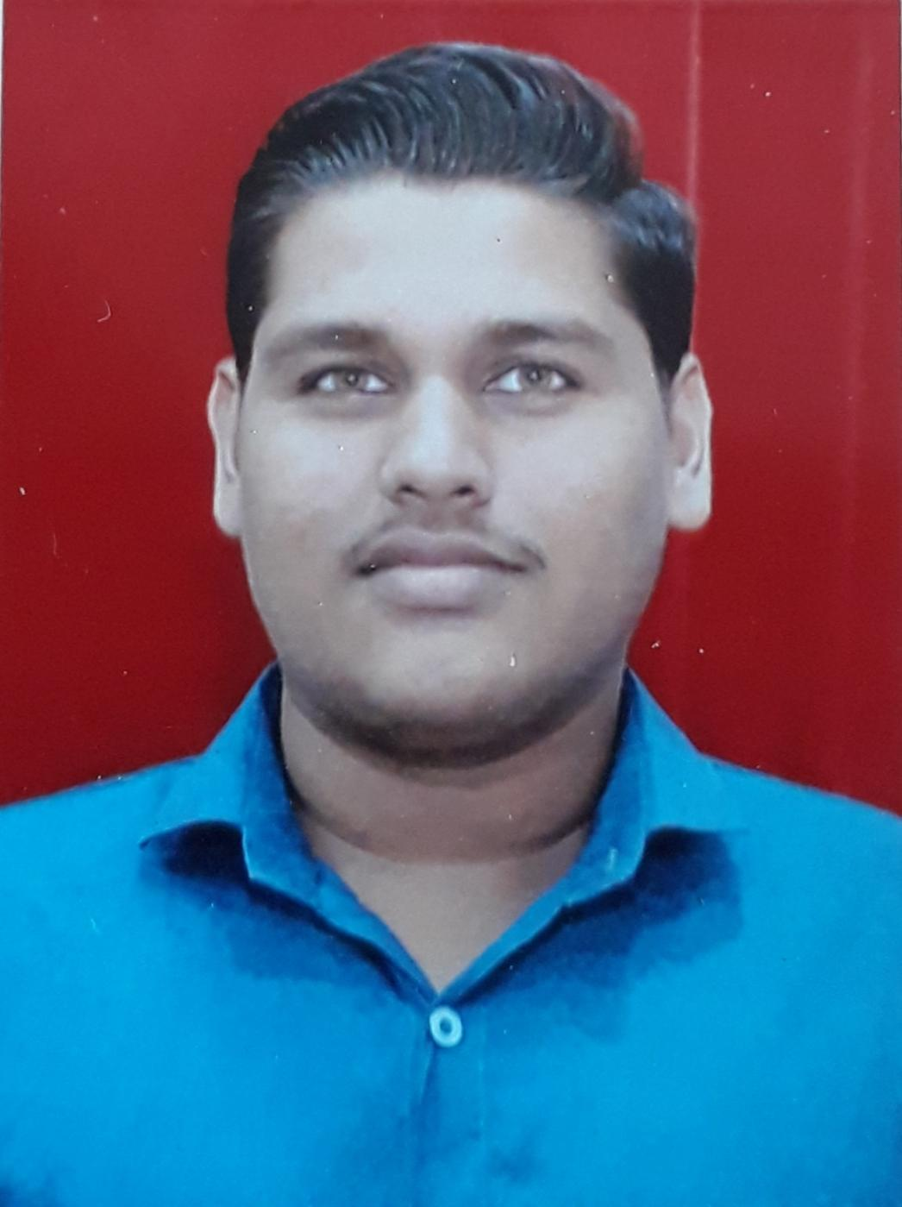

Team Members
Rahul Chavan
https://www.linkedin.com/in/rahul-chavan-87b378229
Rishi Verma
https://www.linkedin.com/in/rishi-verma-1993oct
Muzammil.A
https://www.linkedin.com/in/muzammil-muzzu-0b06a8197
Mohd Aaquib
https://www.linkedin.com/in/muhammad-aaquib-296140213/
Aifaz Shaikh
https://www.linkedin.com/in/aifaz-shaikh-140bb812a
Ritika Verma
https://www.linkedin.com/in/ritika-verma-a0b88b1b9

Slide 6
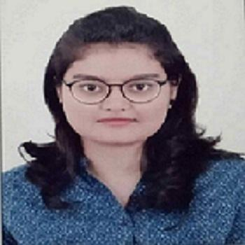

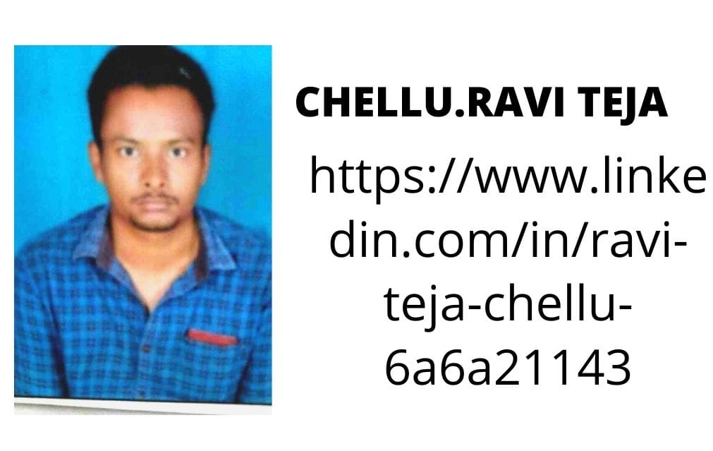
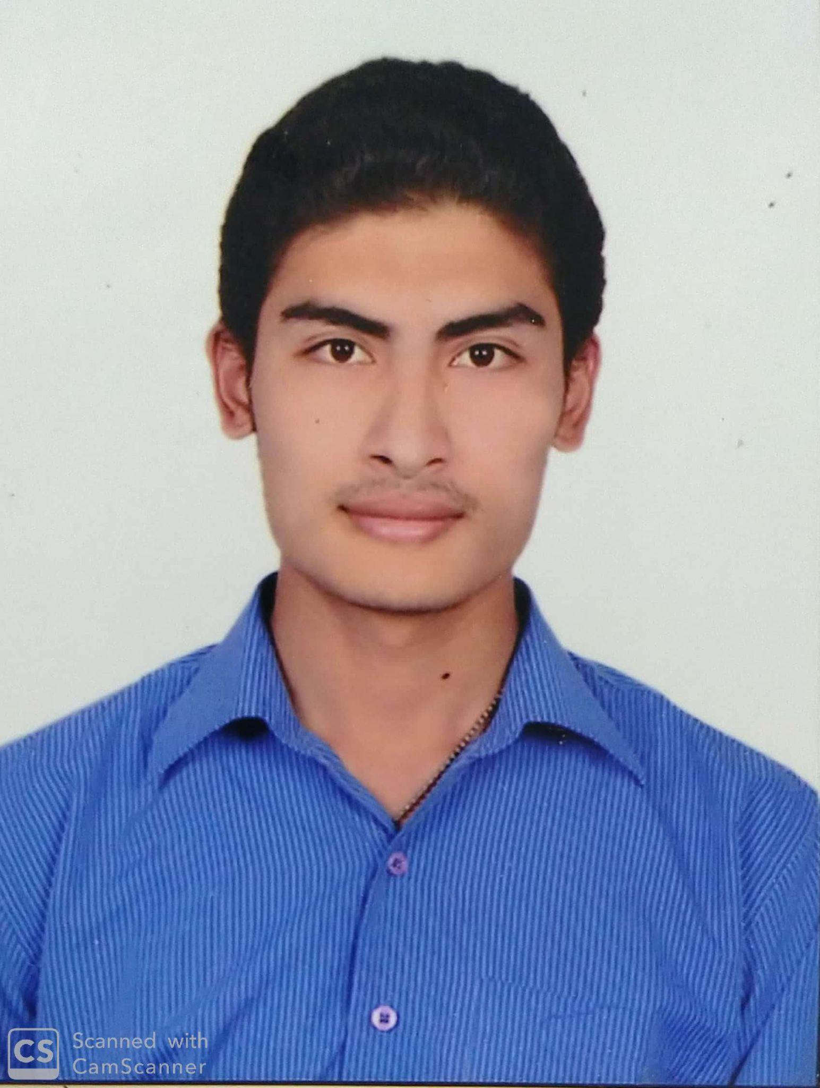


Team Members
Aradhana Jit
https://www.linkedin.com/in/aradhana-jit-81a7311b4/
Bhanu Prakash
https://www.linkedin.com/in/bhanu-prakash-9bb330108
CHELLU. RAVI TEJA
https://www.linkedin.com/in/ravi-teja-chellu-6a6a21143/
Mohd Inzemam
https://www.linkedin.com/in/inzemam-ulhaque-28941821b
Deepak Bhatlavande (As Team Leader)
linkedin.com/in/deepak-bhatlavande-0a26aa55
Anilkumar Damera
https://www.linkedin.com/in/anil-kumar-damera-6a3130107/

Slide 7
Content
Project Introduction
Project Overview and Scope
Project Goal
Success Criteria
CRISP-ML(Q)Methodology
Technical Stacks
Project Architecture
Data Understanding
Data Preparation
Exploratory Data Analysis
Model Selection and Building
Deployment
Future scope
Conclusion

Slide 8
Introduction
India is one among the oldest countries which is still practicing agriculture. But in recent times the trends in agriculture has drastically evolved due to globalization. Various factors have affected the health of agriculture in India. Many new technologies have been evolved to regain the health.
One such technique is Crop Recommendation. Crop Recommendation is the technology of “site-specific” farming. It has provided us with the advantage of efficient input, output and better decisions regarding farming.
Recommendation of crops is dependent on various parameters. Crop Recommendation aims in identifying these parameters in a site-specific manner in order to resolve issues regarding crop selection.

Slide 9
Project overview and Scope
Predicting high demand crop in upcoming season as if done manually is time consuming process.
This project aim is to predict and recommend the best quality and high in demand crop in and around Hyderabad that will yield most benefit out of it.
We are building this model to minimize time for selecting crops which farmer should grow to get good profit , provide as accurate and through results as possible.
Recommendation of crops is dependent on various parameters. This Project aims in identifying these parameters in a site-specific manner in order to resolve issues regarding crop selection.
Notes:
Problem regarding farmer

Slide 10

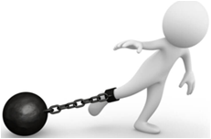
Project Goals
Objectives
Constraints
To Provide recommendation of the best suitable crops in the area so that the farmer does not incur any loss.
To recommend proper crops suitable with soil and environment to the farmer.
Recommend crop with Good Return on Investment.
Lack of timely and hustle free availability of the Data.
Crop recommendation for upcoming season with best return of investment.

Slide 11
Success Criteria
The model Recommends some of the best Crops & return on investment with high accuracy using historical data collected using various agricultural sites & Journals.
Dataset consist of various factors needed for the proper growing of a crop. We have taken into consideration these factors which will be taken as an input from the farmer/authority that will be deciding which crop to sow.
Crop Recommendation helps the farmer to choose the right crop by providing insights that ordinary farmers don’t keep track of thereby decreasing the chances of crop failure and increasing productivity. It also prevents them from incurring losses.

Slide 12
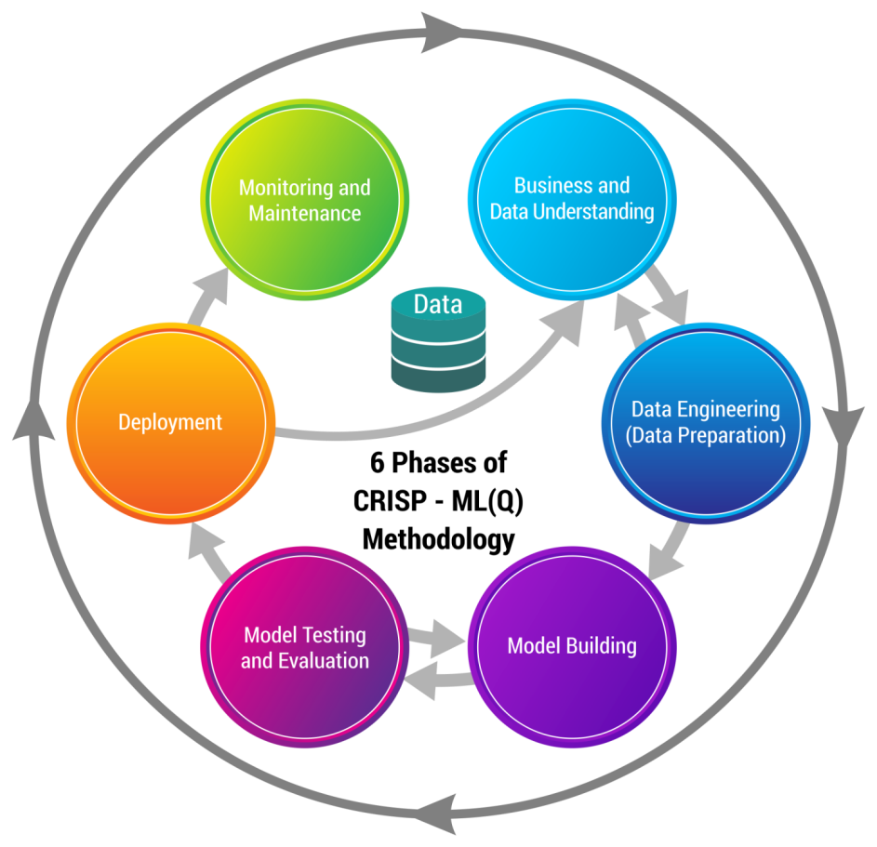
CRISP-ML(Q) Methodology

Slide 13










Technical Stacks
These are some tools and software Environment
we used for our project :-
Python: We used for EDA and Model Building
Python IDE: Jupyter Notebook ,python and Google colab
Python libraries:
Numpy: used for working with arrays
Pandas: Pandas is a widely-used data analysis and manipulation library for Python.
Matplotlib: pyplot is a collection of functions that make matplotlib work like MATLAB. Each pyplot function makes some change to a figure: e.g., creates a figure, creates a plotting etc
Sweet Viz:The system is built around quickly visualizing target values and comparing datasets. Its goal is to help quick analysis of target characteristics, training vs testing data, and other such data characterization tasks.
scikit-learn:Scikit-learn is a library in Python that provides many unsupervised and supervised learning algorithms. It's built upon some of the technology you might already be familiar with, like NumPy, pandas, and Matplotlib!
Seaborn:It provides a high-level interface for drawing attractive and informative statistical graphics.

Slide 14
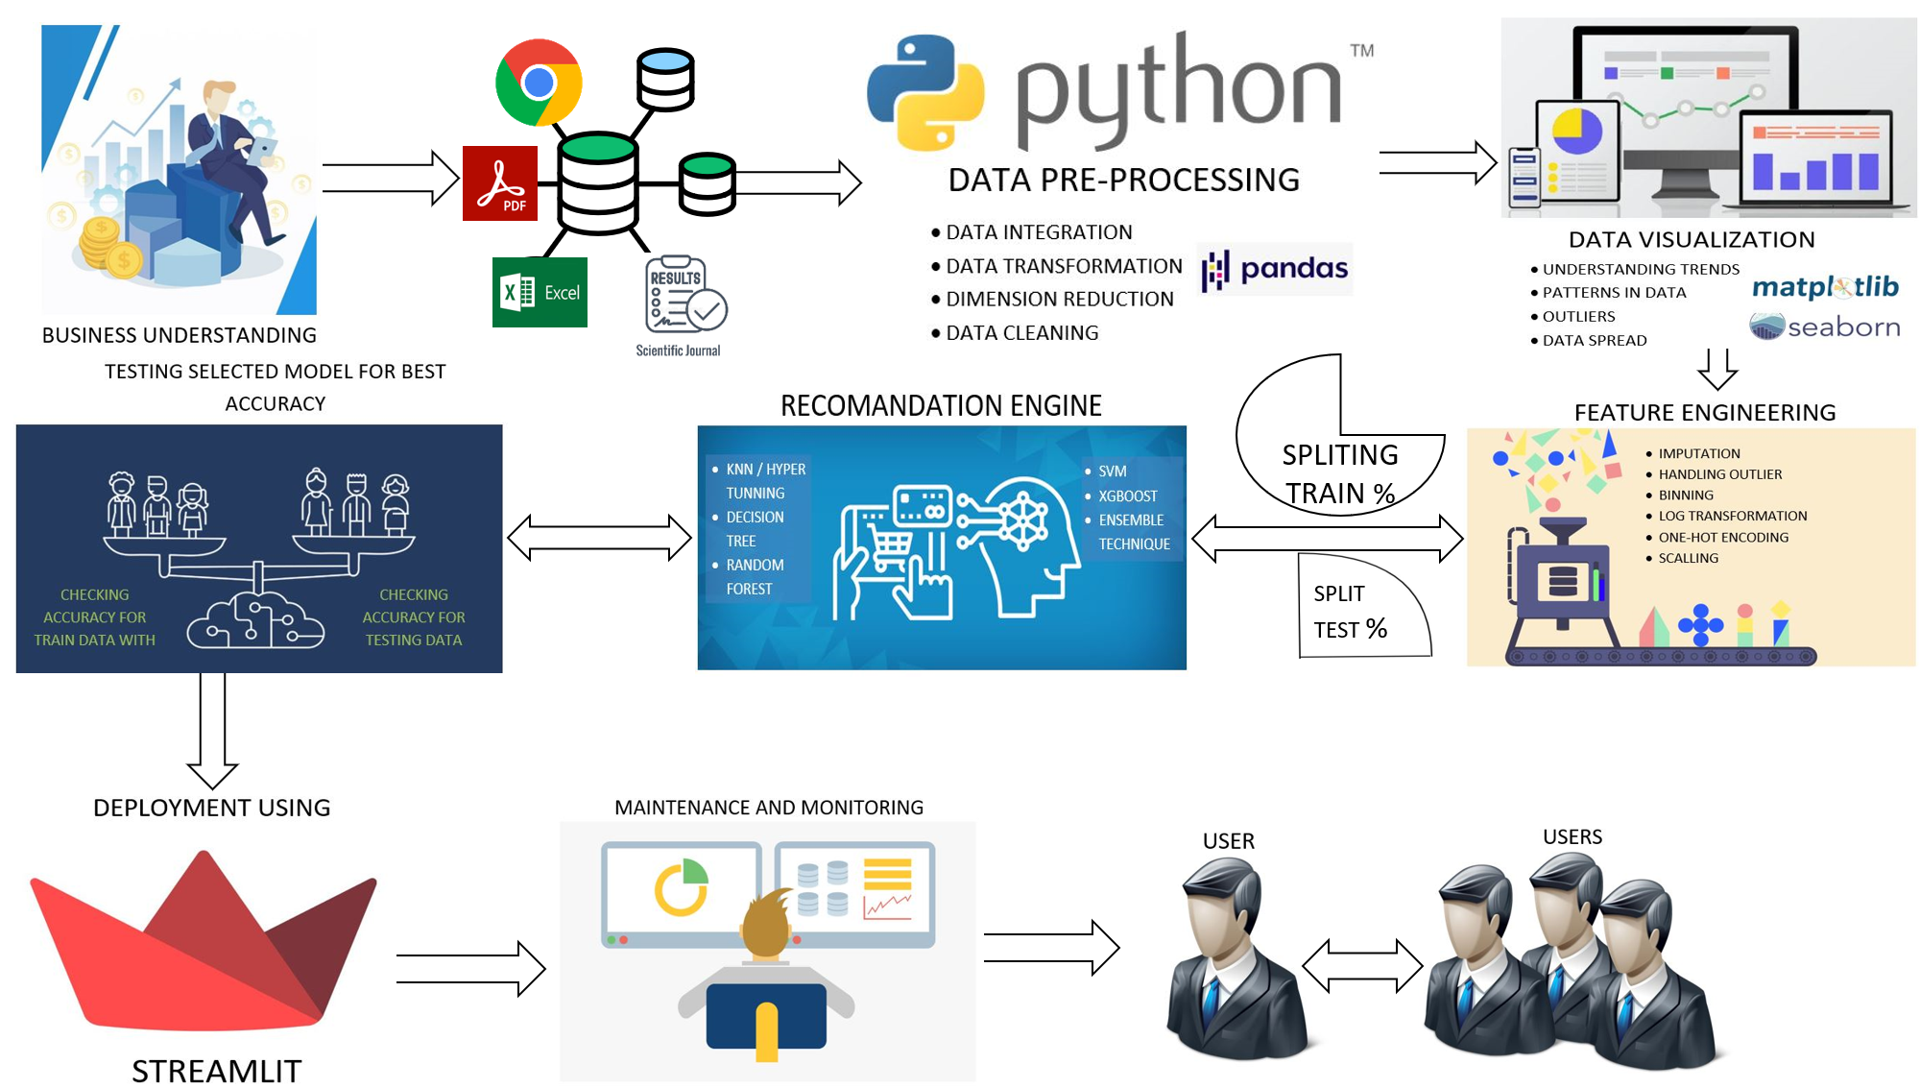
Project Architecture

Slide 15

Data Understanding
Objective : To develop and validate the Model to Recommend the best crop & Return
on investment for particular crop.
Data :
Dataset used is Agri_Data for Crop recommendation & Crop_ROI for Return on
investment prediction which is collected from agricultural websites & journal.It
is in .csv format.
Crop recommendation-: Data used for training the model contains 4921 rows and 12
Columns.
Target Variable: Crop
Independent Variables:District_Name, Season, N kg/ha, P kg/ha,
K kg/ha, ph, Humidity_around, Rainfall, Area, Production, Temp_around.

Slide 16
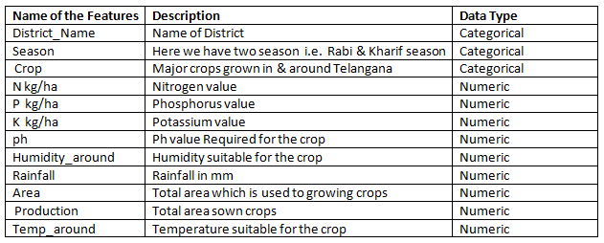
MetaData Crop recommendation

Slide 17
Crop Return on Investment-: Data used for training the model contains 4921 rows and 13 Columns.
Target Variable: (ROI Return On Investment)
Independent Variables: District_Name, Crop, Crop_Duration, Nitrogen, phosphorus, potassium, ph, Pesticides, Yield bags/ha, Seeds kgs/ha, Cost for Cultivation Rs\ha, Cost of pesticides, Investment cost, Price, Net income.

Slide 18
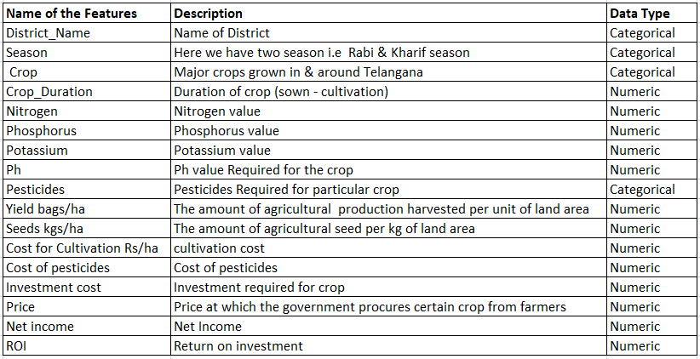
MetaData Crop Return on Investment

Slide 19


Data Preparation
.
The data collected is a primary Source i.e the process of gathering data through survey,journals etc.
Basic cleaning and preprocessing steps were taken to standardize the data.
Removed null values ,duplicate ,low variance ,high correlated values .
Using sckit learn library we standarized ,normalized the data .

Slide 20

Exploratory Data Analysis
(EDA)

Slide 21
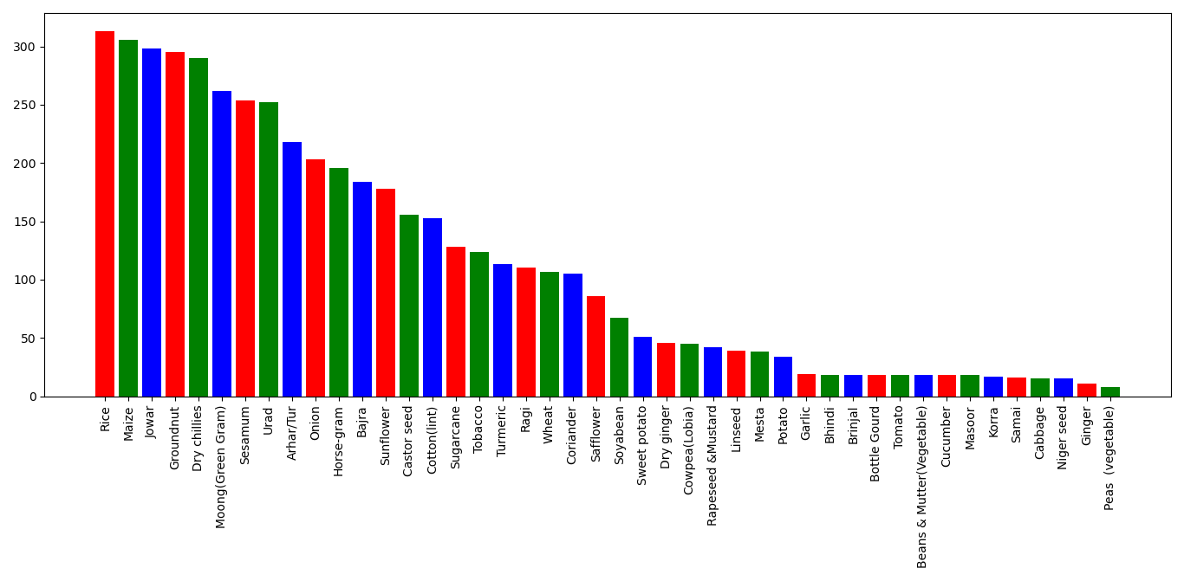
Frequency of Target feature(Crop Recommendation)
From this plot we conclude that Rice has major contribution among all crops & Peas has minor contribution among all crops in & around Telangana.

Slide 22
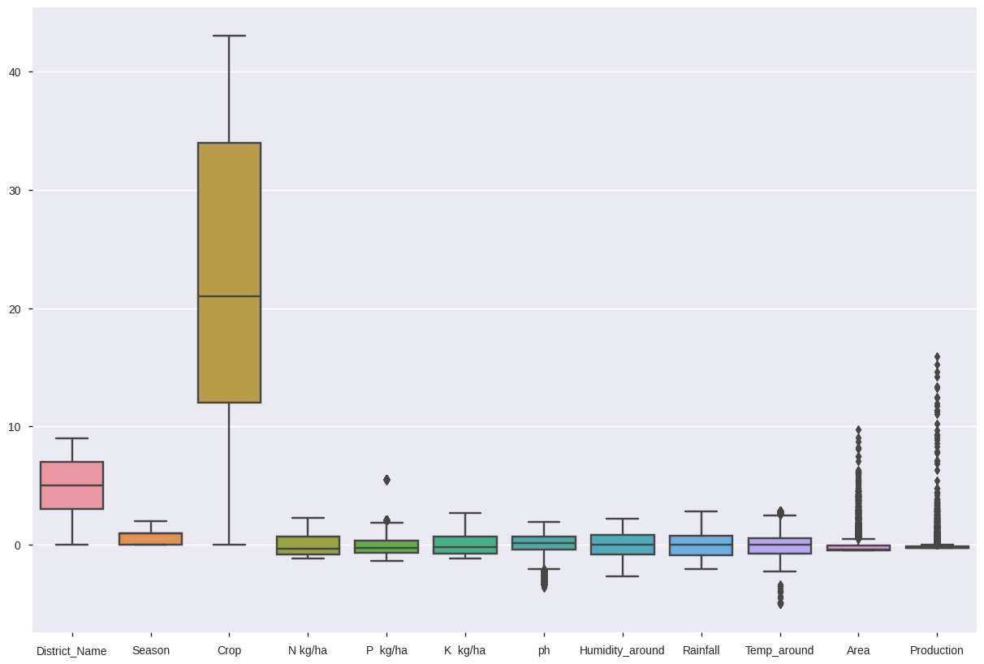
Box Plot of Features(Crop Recommendation)

Slide 24
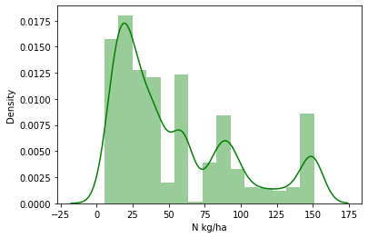
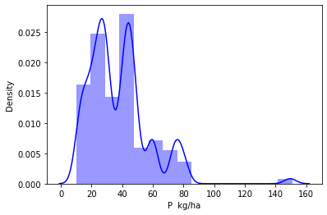
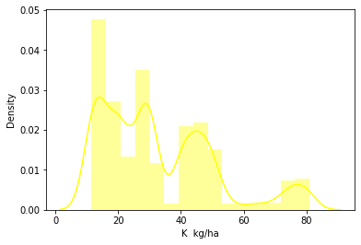
Distribution of Numerical Columns (Independent Variables) Based on histogram
From the graph below, we conclude that distribution of data is right skewed.
From the above graph, we conclude that the distribution of data is right skewed.
From the above graph, we conclude that the distribution of data is right skewed and also some outliers are there.

Slide 25
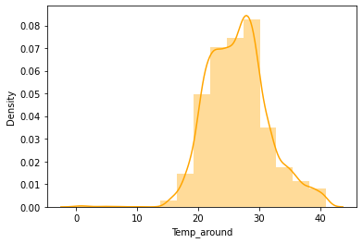
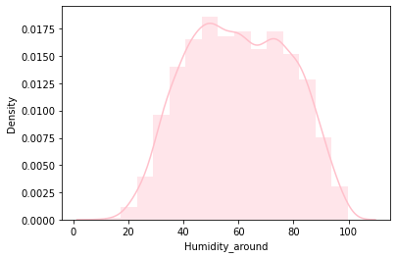
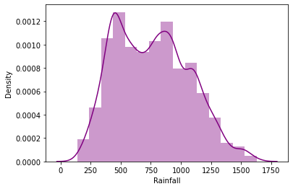
Distribution of Numerical Columns (Independent Variables) Based on histogram
From the graph below, we conclude that distribution of data is slightly right skewed.
From the above graph, we conclude that distribution of data is left skewed.
From the above graph, we conclude that distribution of data is normal distribution.

Slide 26
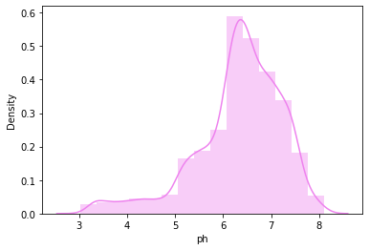
From the above graph, we conclude that distribution of data is left skewed.

Slide 27
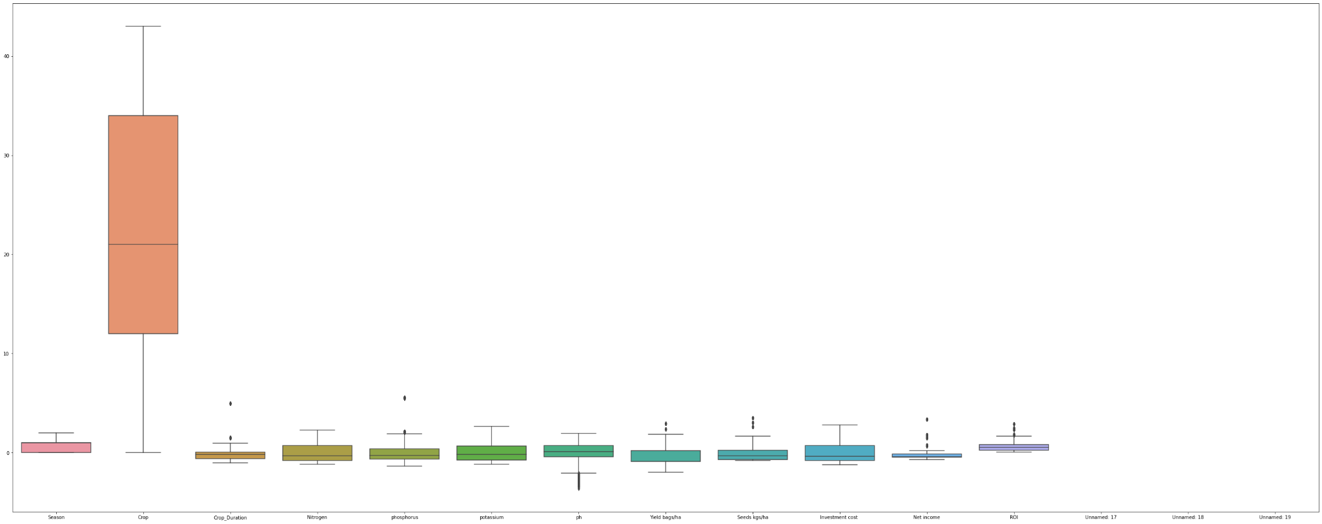
Box Plot of Features(Crop Return On Investment)

Slide 28
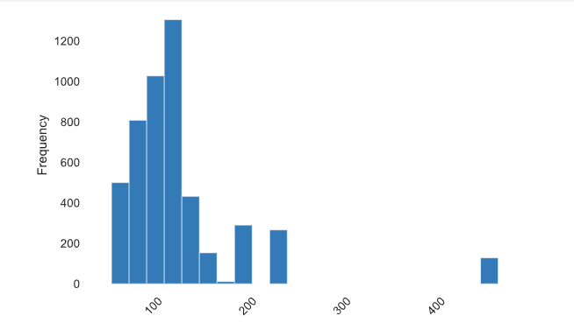
Univariate plot (CROP Return On Investment)
Crop Duration
From the graph, we conclude that the distribution of data is normal and some outliers are there.
Mostly, all crops duration in between 50 to 150 days.

Slide 29
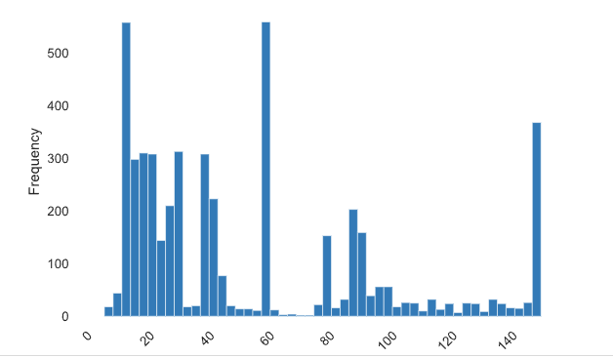
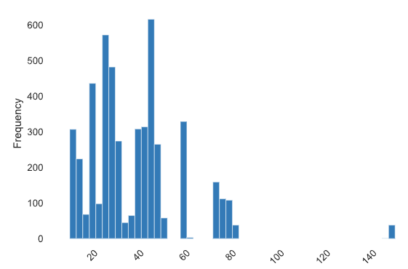
Nitrogen- From the above graph, we conclude that the distribution of data is right skewed.
Phosphorus- From the above graph, we conclude that the distribution of data is right skewed and also some outliers are there.

Slide 30
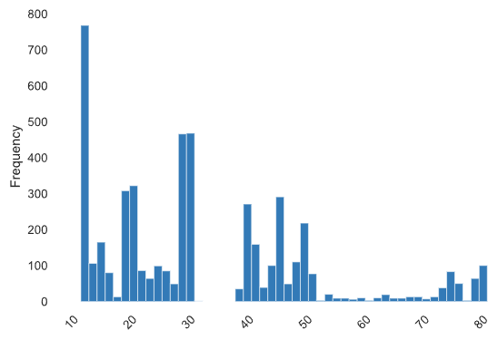
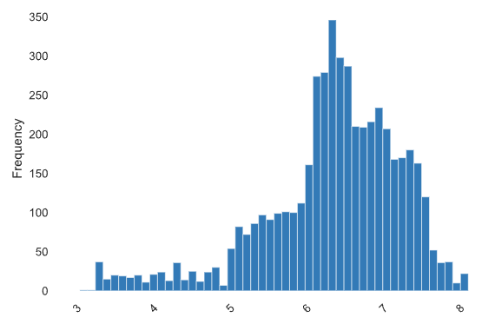
Potassium- From the above graph, we conclude that distribution of data is right skewed.
Ph- From the above graph, we conclude that distribution of data is left skewed.

Slide 31
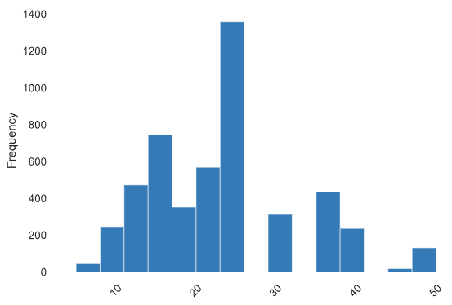
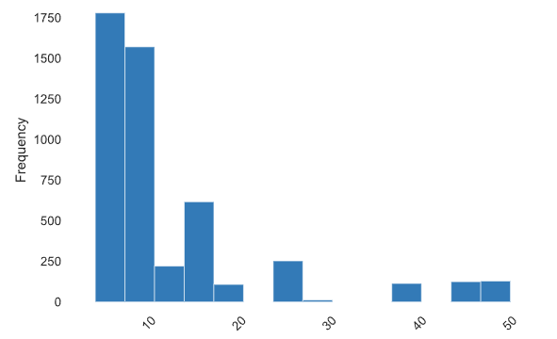
Yield bags/ha- From the above graph, we conclude that distribution of data is normal..
Seed kg/ha- From the above graph, we conclude that distribution of data is right skewed.

Slide 32
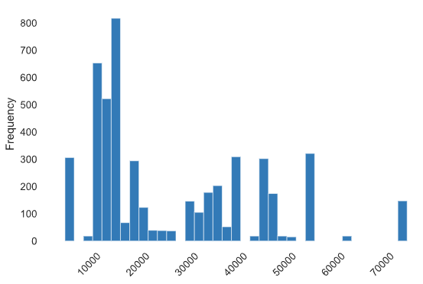
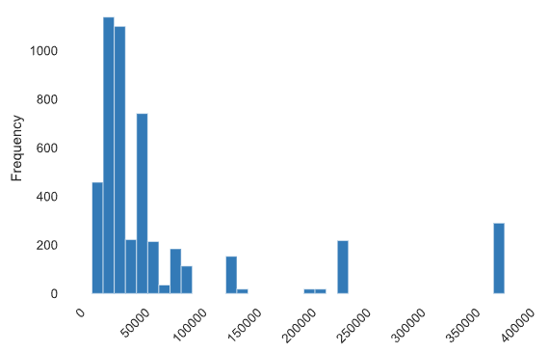
Cost for Cultivation– From the above graph, we conclude that distribution of data is right skewed and also outliers are present.
Net income- From the above graph, we conclude that distribution of data is right skewed and also outliers are present.

Slide 33
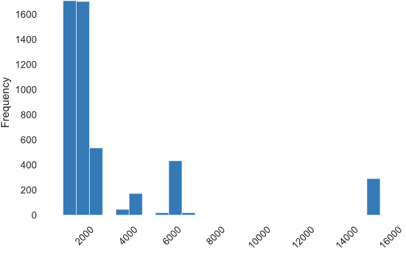
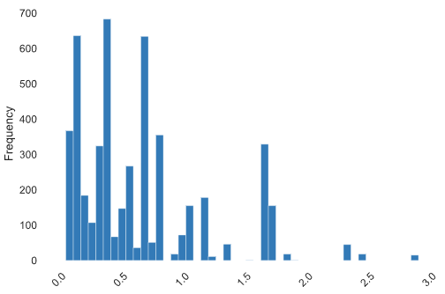
Price- From the above graph, we conclude that distribution of data is right skewed and also outliers are present.
ROI- From the above graph, we conclude that distribution of data is right skewed and also outliers are present.

Slide 34
Bivariate Analysis

Slide 35
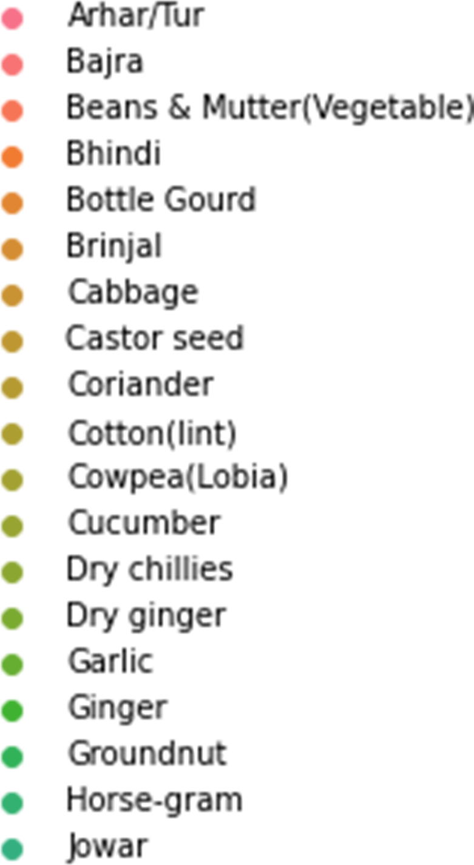
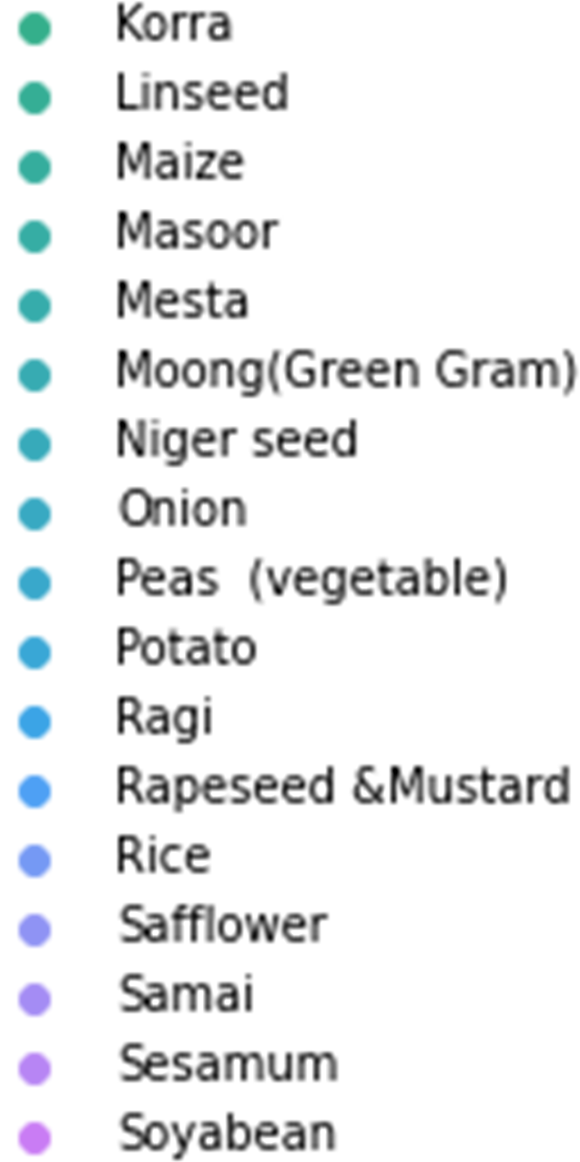
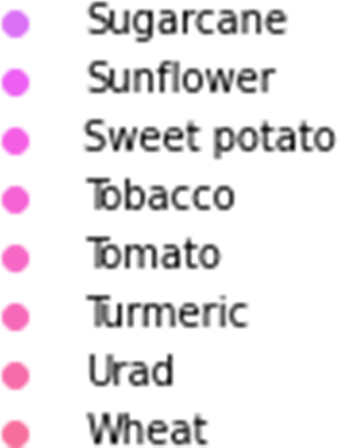
Color Legend (CROPS)

Slide 36
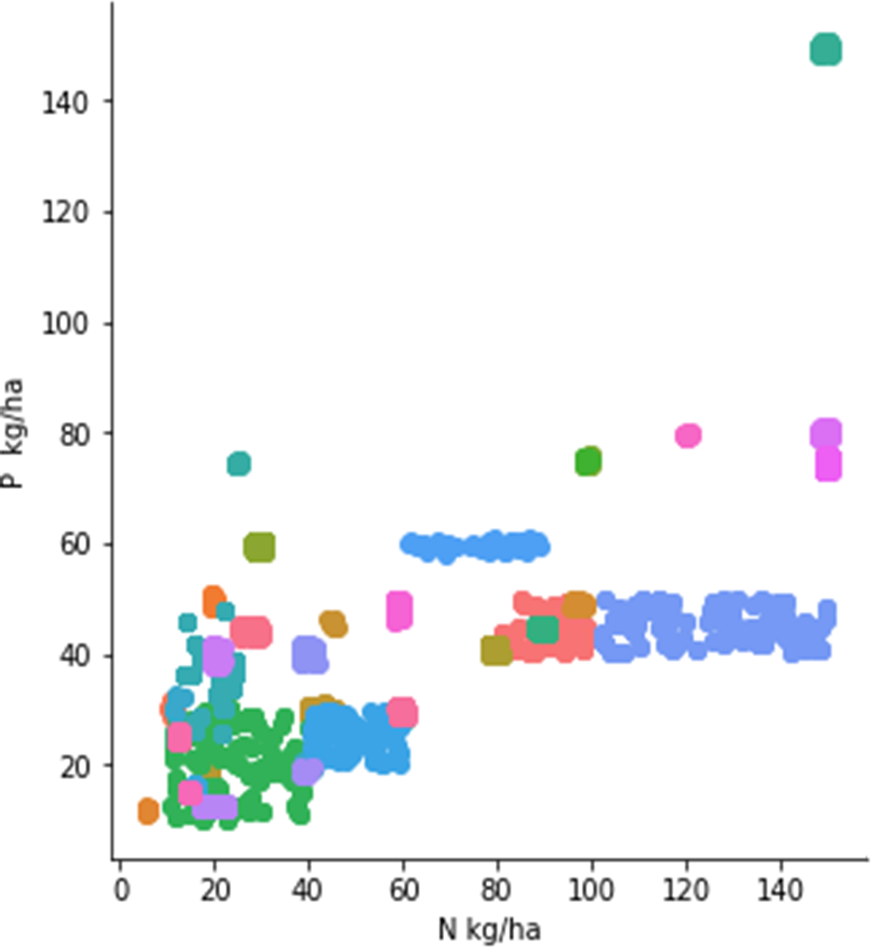
Nitrogen VS phosphorus
Nitrogen is in a low degree of positive correlation with phosphorus.
Rice crop is high in nitrogen and phosphorus.
Ginger crop is low in nitrogen and phosphorus.

Slide 37
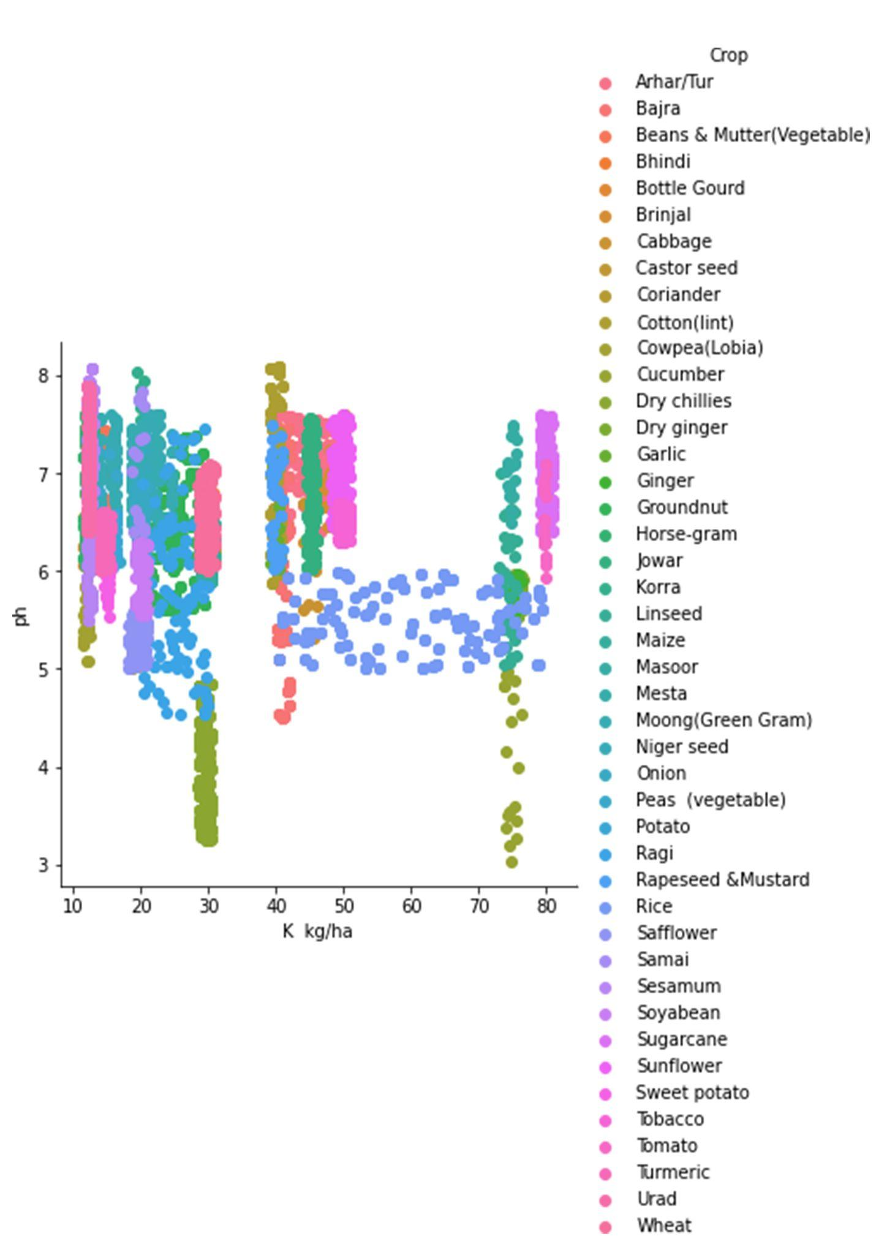
PH VS potassium
Potassium is no correlation with ph.
Sugarcane crop is high in potassium and ph.
Cucumber crop is low in potassium and ph.
Rice crop is average in potassium and ph.

Slide 38
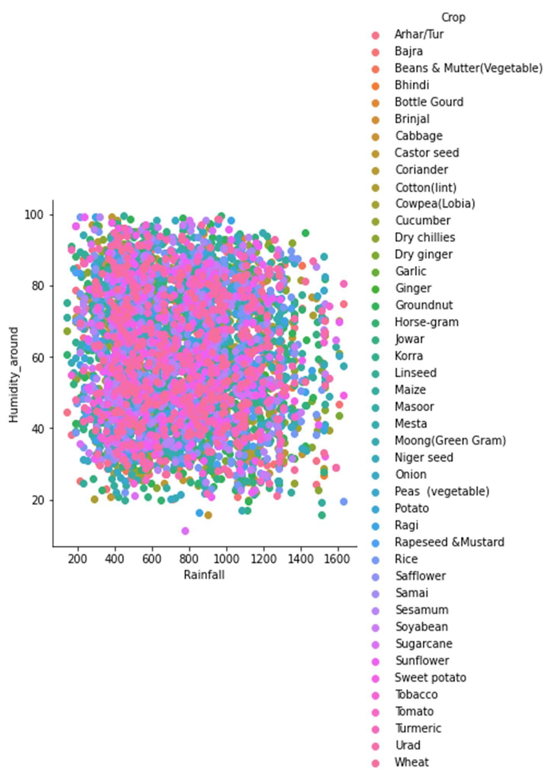
Humidity VS Rainfall
Rainfall is no correlation with humidity.
All crops need average rainfall and humidity.

Slide 39
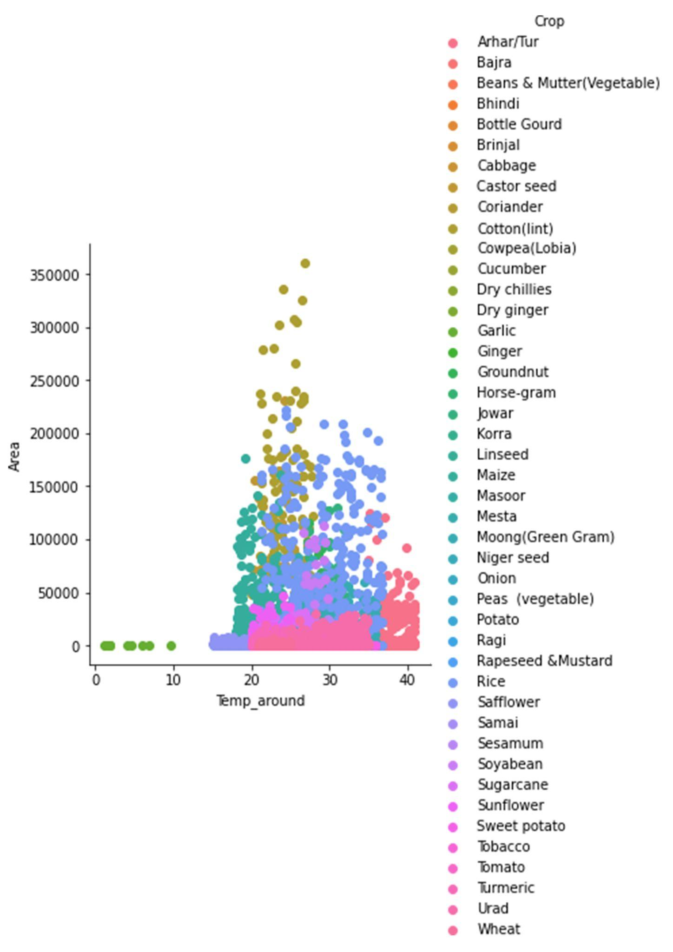
Temprature VS Area
Temperature is no correlation with Area.
Arhar/Tur crop is high in Temperature and low in Area.
Ginger crop is low in Temperature and Area.
Rice crop is average in Temperature and Area.

Slide 40
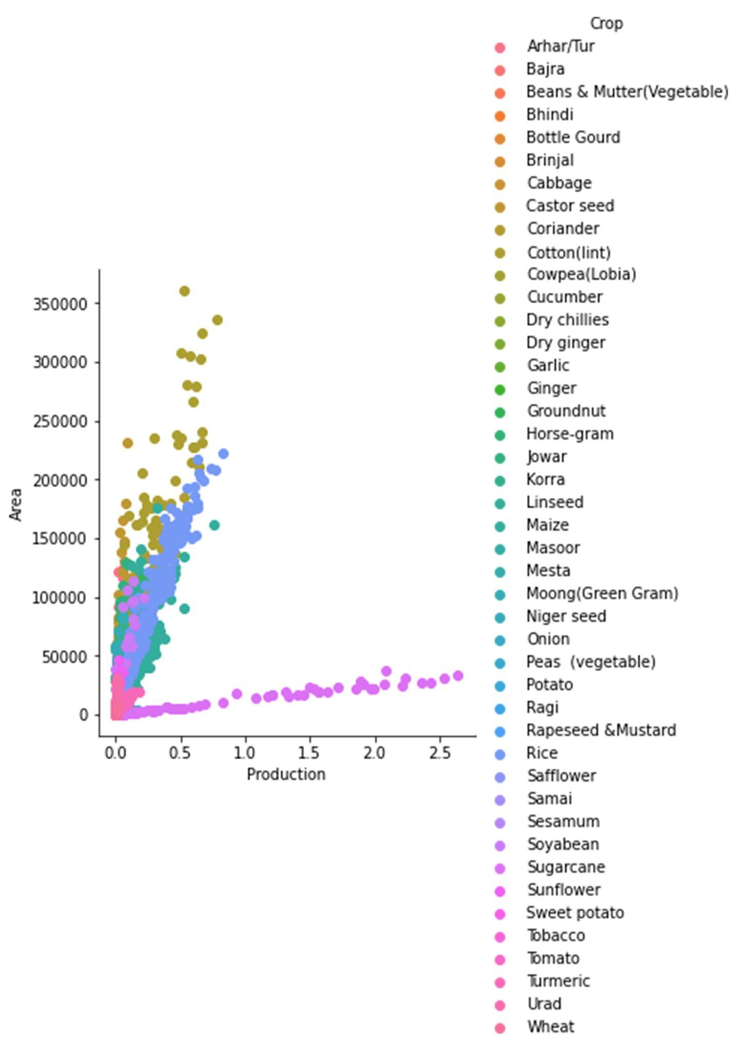
Area VS Production
Production is in a low degree of positive correlation with Area.
Cotton crop is high in area and low in production.
Sugarcane crop is high in production and low in area.
Wheat crop is low in production and area.

Slide 41
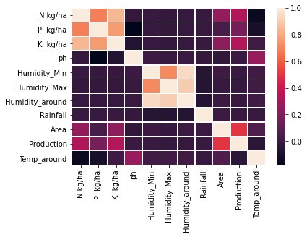
Correlation Plot(Crop Recommendation)

Slide 42
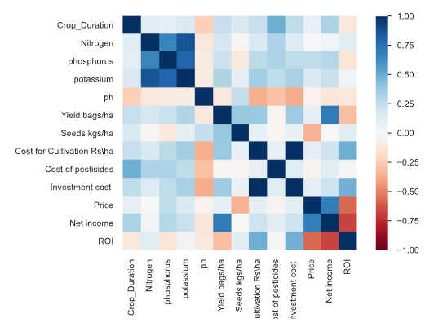
Correlation Plot(Crop ROI)

Slide 43
Model Approach & Features

Slide 44
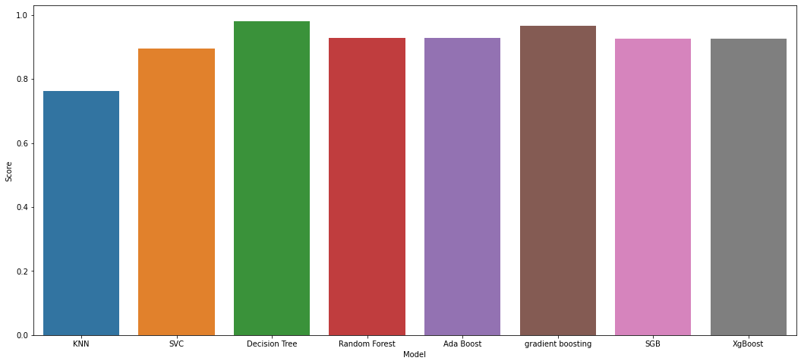
Accuracy Score (Crop Recommendation)

Slide 45
XG-Boosting:
XGBoost or extreme gradient boosting is one of the well-known gradient boosting techniques(ensemble) having enhanced performance and speed in tree-based (sequential decision trees) machine learning algorithms. XGBoost was created by Tianqi Chen and initially maintained by the Distributed (Deep) Machine Learning Community (DMLC) group. It is the most common algorithm used for applied machine learning in competitions and has gained popularity through winning solutions in structured and tabular data. It is open-source software. Earlier only python and R packages were built for XGBoost but now it has extended to Java, Scala, Julia and other languages as well.
Accuracy:-
Test - 92.52 precision-0.93 recall -0.91 f1 score -0.92
Train-92.54

Slide 46
Model Approach & Accuracy(Crop ROI)
XG-Boosting:(Regression)
XGBoost is an optimized distributed gradient boosting library designed to be highly efficient, flexible and portable.It implements machine learning algorithms under the Gradient Boosting framework.XGBoost provides a parallel tree boosting (also known as GBDT, GBM) that solve many data science problems in a fast and accurate way.
XGBRegressor Score= 0.025318534570564218
Mean squared error: 0.00
R Square score: 1.00

Slide 47
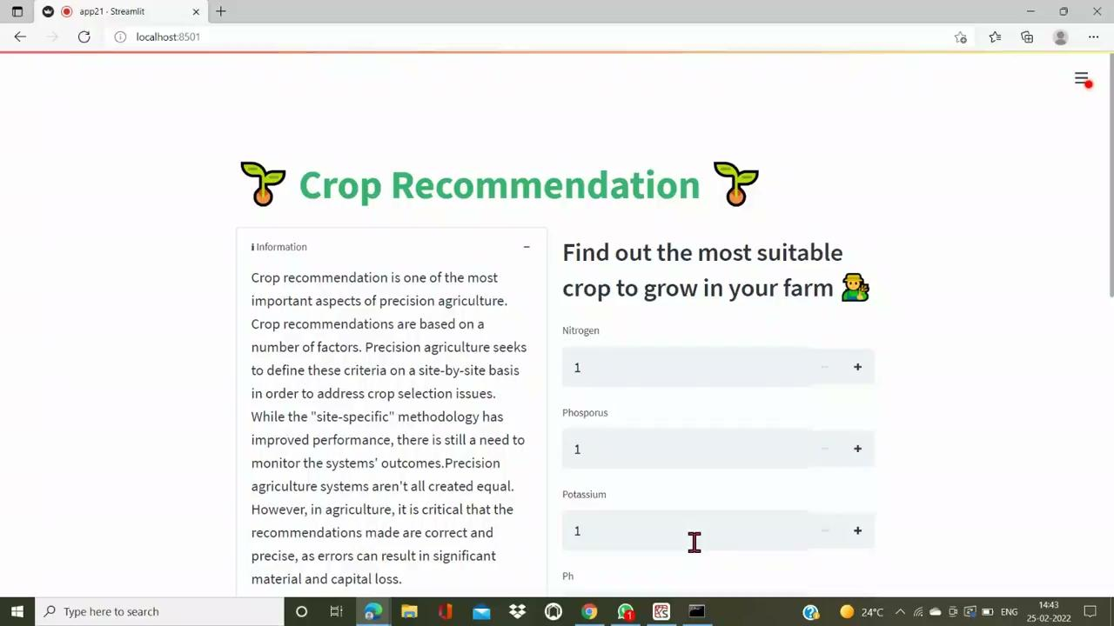
Deployment Output

Slide 48
Future Scope
The prediction of crop yield based on location and proper implementation of algorithms have proved that the higher crop yield can be achieved.
Building this particular application in the regional languages, so that it would be more comfortable for farmers.
Crop disease detection and prevention.
A generalized prediction model for various crops by considering other parameters like humidity and solar radiation can be developed.
Give information about micronutrients also.

Slide 49
Conclusion
India is a nation in which agriculture plays a prime role. In prosperity of the farmers, prospers the nation.
Thus our work would help farmers in sowing the right seed based on soil requirements to increase productivity and acquire profit out of such a technique.
Thus the farmer’s can plant the right crop which will increase their yield and will also increase the overall productivity of the nation. Our future work is aimed at improving data set with large number of attributes and also implementing yield prediction.

Slide 50
References
Description | Link
Soil moisture content as influenced by varied levels of irrigation | https://www.researchgate.net/publication/348870244
Crop Yield Prediction by using Machine Learning Techniques | https://www.annalsofrscb.ro/index.php/journal/article/view/5869
Geographical Study Impact of Climate | https://drive.google.com/drive/folders/1tqMMpkEa4P_-t9bbApRMSuPXEhhjeQ7j

Slide 51


